Slide 1


Inventory Management System
Dan Harrison

Slide 2


Content
The task
MVP
Project Management
Demonstration
Testing
Issues
Future Development

Slide 3
The Task
Create an Inventory Management System based on starter code given, with basic functionality to allow a business to manage their Customers, Items, and any Orders.

Slide 4
MVP
Full CRUD functionality for Orders, Items, and Customers
JDBC Connection with tables to store all information
Usable from Command Line

Slide 5
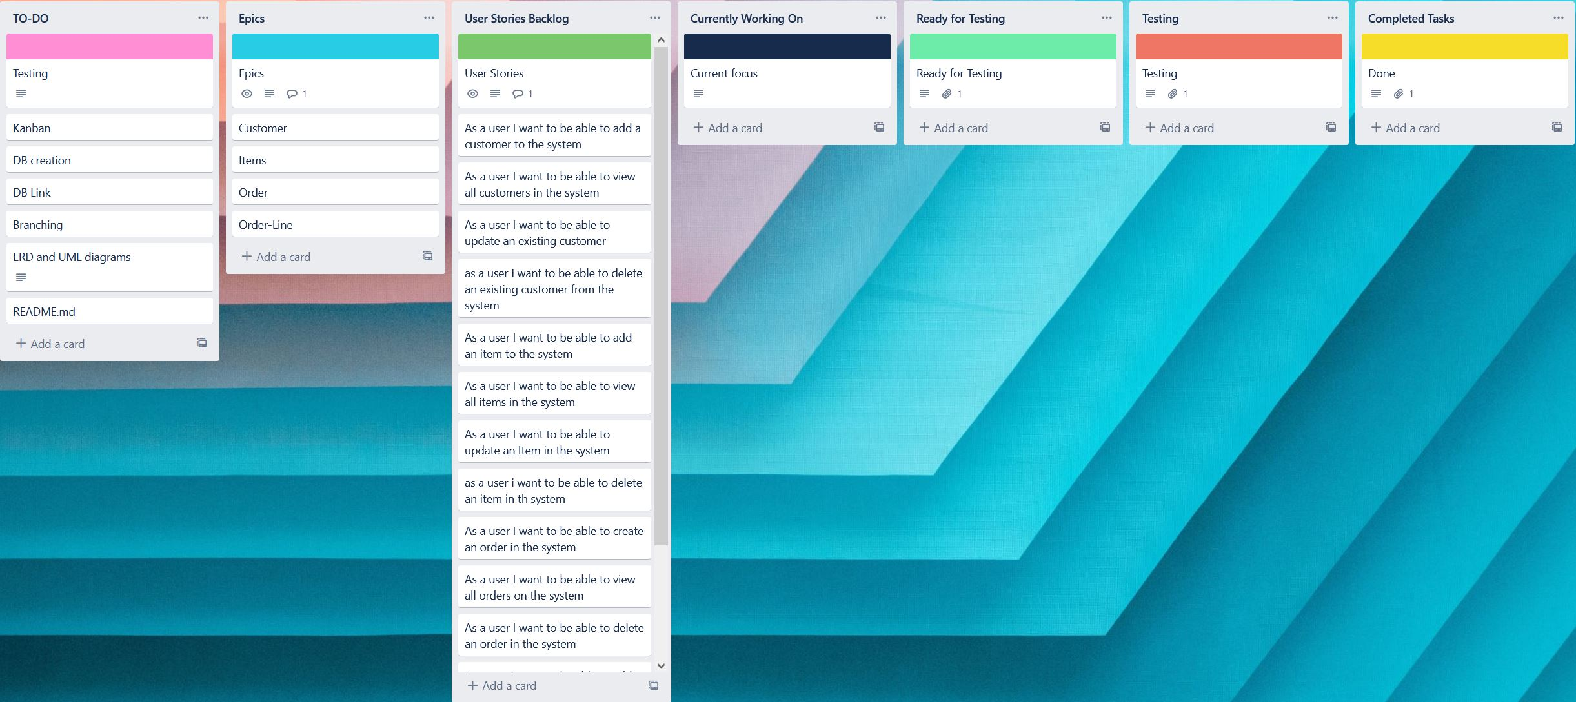
Project Management
Kanban Board – Trello

Slide 6
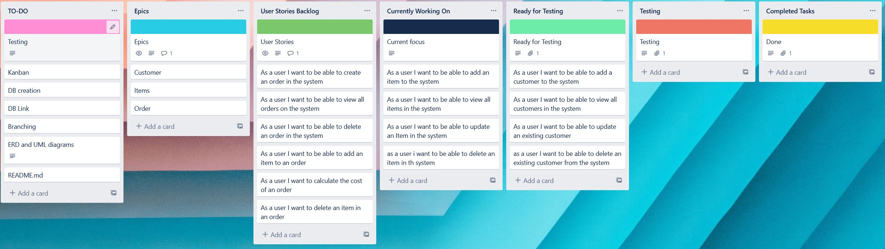
Project Management
Kanban Board – Trello

Slide 7
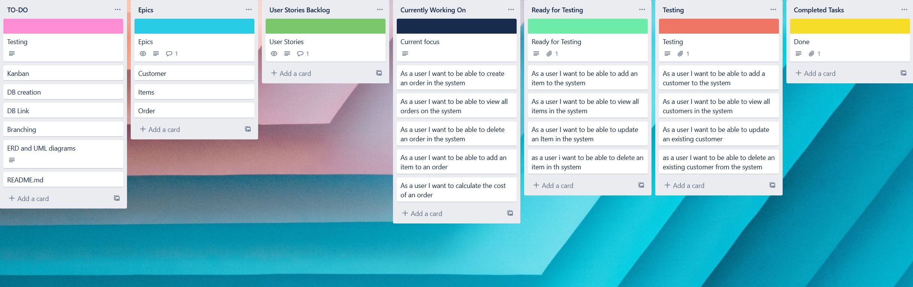
Project Management
Kanban Board – Trello

Slide 8
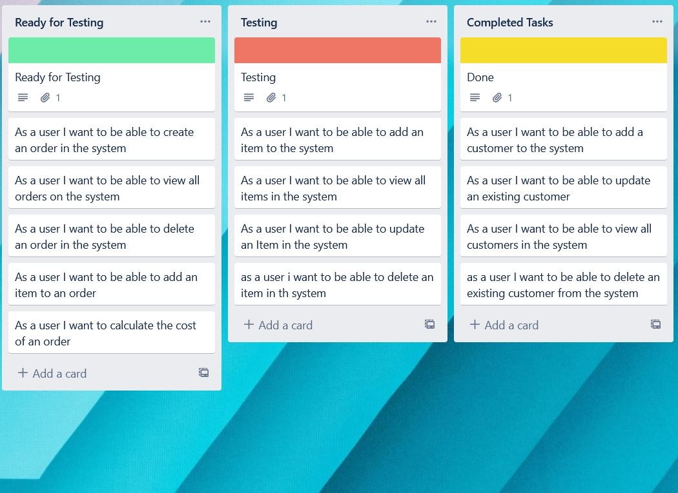
Project Management
Kanban Board – Trello

Slide 9
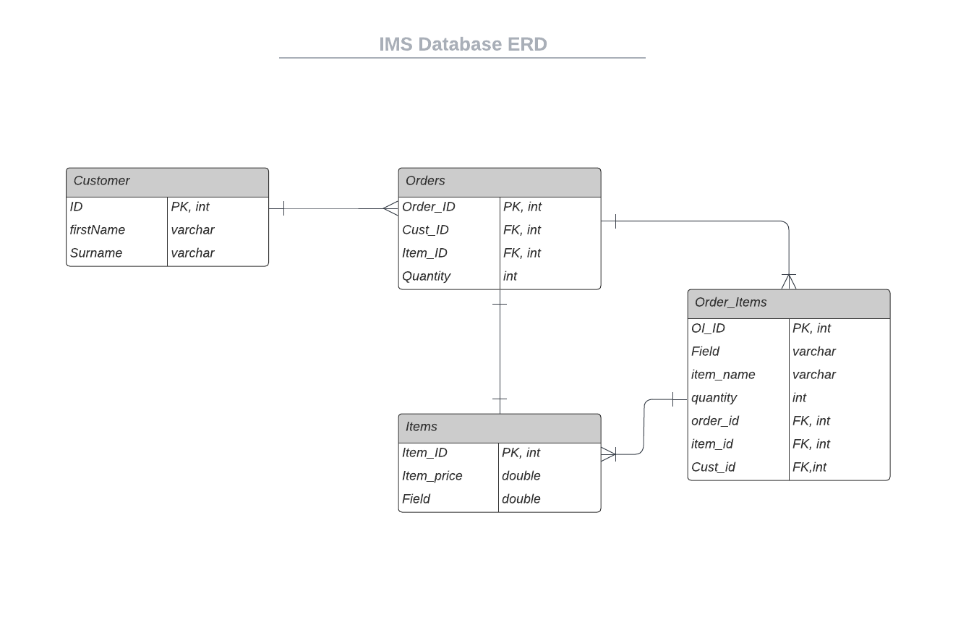
Project Management
Entity Relationship Diagrams – LucidChart

Slide 10
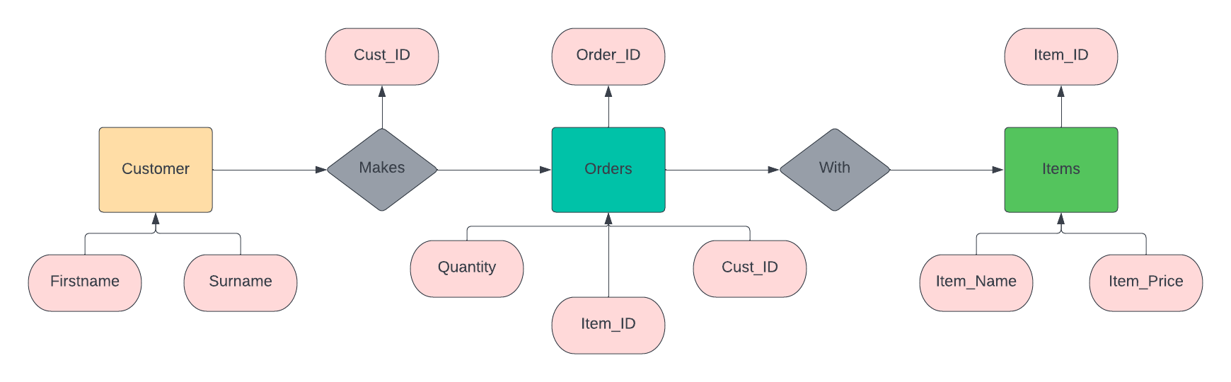
Project Management
Entity Relationship Diagrams – LucidChart

Slide 11
Project Management
MoSCoW prioritisation
Version Control – Git
Feature Branch Model

Slide 12
Product Demo
How a user would interact with the product
CRUD functionality
Code overview

Slide 13

Testing
JUnit
Mockito
63% Overall Testing coverage

Slide 14
Issues
Feature Branch Model
Testing
Maven Builds

Slide 15
Future Development
More functionality (Stock Control, Invoicing)
Graphical User Interface
Implementations with other applications (Shipping Controller)

